Slide 1

Beyond the Structure of Attitudes
Belief Systems, Affect, and Polarization
Steven Lauterwasser
Postdoctoral Research Associate
Notes:
Good afternoon! Thanks for coming.
Thank you to Professor Cannon for organizing and presiding and to everyone presenting as well.
My name is Steven Lauterwasser and I'm a postdoc at Northeastern where I work, quantitatively, on the co-constitution of identity, knowledge, and political conflict.
Today I want to talk to you about something of practical interest to anyone concerned with the current state of American politics and of academic interest to almost anyone doing quantitative work on individual beliefs.
Specifically, I want to talk to you about belief systems, affect, and political polarization.
I want to talk about affect and belief systems because previous quantitative work on belief systems has really left affect and emotions out.
But I want to argue that emotions are a fundamental part of what a belief system is and that we lose a lot by ignoring them.
Because the question of whether and how affective feelings are connected to a belief system is an *empirical* question, the answer to which is itself an important characteristic of that system.
And I'm gonna demonstrate why and how this matters by showing how this insight helps us understand polarization, enabling a synthesis of previously competing theories of attitudinal and affective polarization.
The first step in the argument, however, is defining what it means to approach beliefs as a "system".

Slide 2
Defining a System
Usually assume that beliefs are…
Discrete and independent
Meaningful in themselves
Consistent in causes and consequences
Usually assume that beliefs are…
Discrete and independent
Meaningful in themselves
Consistent in causes and consequences
In a system, beliefs are…
Connected and interdependent
Meaningful in relation
Variable in causes and consequences
Notes:
Understanding beliefs as a system means *rejecting* some common baseline assumptions implicit (and sometimes explicit) in most regression based work on beliefs or attitudes.
[click] We usually assume beliefs are...
[click] Discrete and independent
[click] Meaningful in themselves
[click] Consistent in causes and consequences
- That is, the same belief works basically the same way across people.
The basic insight of a belief system perspective is that this isn't true. [click]
[click] Instead, in a system, beliefs are…
[click] Connected and *inter*dependent
[click] Meaningful in *relation* to one another
[click] *Variable* in causes and consequences
- Because the belief itself isn't the only thing that matters
There are a lot of different versions of this insight, but here are a few concrete/intuitive examples:
- Opposition to abortion which comes along with a belief in fetal personhood likely has different causes and consequences than opposition which doesn't.
- Put another way, we could say that the *way in which* a belief in fetal personhood matters is in how it influences or inflects beliefs about abortion.
- Or, for a different, perhaps more fundamental example: what exactly a belief in "free speech" means is determined entirely by what you think counts as speech.
Thinking about belief systems as *networks* is one very flexible and intuitive way to conceptualize this: each separate belief is a node, connected with other beliefs by ties of mutual influence of various kinds, some tighter, some looser.
[click]

Slide 3
A Network of Beliefs
Boutyline & Vaisey 2017: survey responses → belief network
Question → Node
Pairwise correlation → Edge
The structure of the network is the structure of the system
Dense connections = consistent system
Central node = organizing belief
But something is missing…
Emotion
Notes:
Belief network analysis, developed by Andrei Boutyline and Stephen Vaisey, operationalizes this idea as a correlational network among survey responses. [click]
By treating every [click]question as a node and the [click](squared) correlation between each pair of questions as an edge, we can create an aggregate belief network for the surveyed population.
[click]
The structure of the resulting network then corresponds to the structure of the underlying belief system (in the aggregate).
For instance:
[click] Dense connections = consistent system
[click] Central node = organizing belief
[click] But something is missing:
[click] Emotion is really absent from quantitative work on belief systems in general, even though it shows up in some more qualitative conceptions.
So, what would it look like to add affect in to belief network analysis?
[click]

Slide 4
A system of Affect?
Affect is…
Embodied, reactive, unconscious
unconscious appraisal
Facilitates cognition
"Common currency" of evaluation (Clore & Schiller 2018)
Could do the same for beliefs
Does it?
Notes:
Well, the natural first question is whether it even makes sense to include affect in a belief network at all?
Surely propositional attitudes and affective feelings/reactions are fundamentally different kinds of thing?
And yes, they are different. Roughly speaking, beliefs are propositional, cognitive, and semantic, while [click]affect is...
[click] Embodied, reactive, unconsious
But those feelings are not *random*, rather they are *responses* to a some stimulus.
And those responses are...
[click] unconscious appraisal
They convey unconscious evaluations about a situation, perception, or thought to our conscious mind.
And in this way they not only *influence* our cognition, but also [click]facilitate it, because affect enables connections and comparisons which would otherwise be nonsense.
It does this by providing a...
[click] "common currency" of evaluation.
Question: "Why is a raven like a writing desk?"
Answer: "Because they both make me anxious." Or excited, or terrified, etc.
In other words, they are related by how they make you *feel*.
[click] And we can imagine that affect may help link otherwise disparate attitudes together in much the same way.
So the question is empirical [click]: in any particular network, what is the structural relationship among propositional attitudes and affective evaluations and what does it tell us?
What I want to convince you of today is that, in the case of political polarization, it can actually tell us quite a bit.
[click]

Slide 5
What’s polarization and Why do We care?
"Us" vs. "Them"
Two approaches:
Attitudinal (Constraint)
Affective
Empirically: both increasing
What do they tell us together?
Notes:
[click] Conceptually, polarization is perhaps best understood as the division of society into an "us" and a "them" between whom compromise is less and less possible and conflict is more and more fierce, creating feelings of existential conflict and ultimately undermining democracy.
[click]
[click] But there are multiple ways of conceptualizing "us" and "them".
[click] From a belief system perspective, we have attitudinal theories of polarization, specifically those focused on *constraint*.
[click] Here, polarization is about attitudinal disagreement, but not its magnitude. Instead, we care about *structure*:
how different opinions/attitudes correlate (or align) with one another
*cross-cutting* attitudinal cleavages bridge across one another, creating stability and pluralism, while
*overlapping* cleavages reinforce one another, reorienting society around fewer lines of conflict, creating polarization.
[click] On the other hand, we have affective theories, where polarization is a matter of how different groups *feel* about one another.
[click] In short, agreement and disagreement don't matter when you hate each others' guts.
[click] Empirically, both approaches find increasing polarization over the past several decades.
Thus far, these theories have largely been placed in *competition* with one another.
[click] But I think they can tell us more if we consider them *together*.
[click]

Slide 6
The Goal
Similar enough to be comparable, different enough to be useful
Replicate what we already know
Tell us something new
Notes:
So, if I want to show you a successful combination of propositional attitudes and affective judgments using belief network analysis, then I need to show three things.
[click] First, that affective and attitudinal networks are similar enough to be comparable, different enough to be useful.
[click] Second, that this combination empirically replicates what we already know: namely that polarization has been increasing over the past several decades.
[click] And finally, that we actually learn something new by bringing affect in. (Specifically, that the empirical question of *how* the affective and attitudinal networks are connected tells us something.)
So, how does belief network analysis get us there?
[click]

Slide 7
Implementation: Data
American National Election Studies, 1992 and 2016
Both affective and attitudinal political items
Sufficient time span
Consistent questions
80 overlapping items
56 attitudinal items
24 affective items
Notes:
Well, it starts with data; specifically [click] the American National Election Studies from 1992 and 2016.
These give us what we need, namely:
[click] Both affective and attitudinal *political* items in order to create networks covering the opinions and emotions we care about.
[click] Sufficient time span to let us replicate findings of increasing polarization over *decades*.
[click] And consistent questions over time because we need identical networks to compare.
Specifically, between 1992 and 2016, we have a total of...
[click] 80 overlapping items
[click] With 56 attitudinal items
- Things like ideological self ID, opinions on government spending, religion, welfare, foreign policy, etc.
[click] And 24 affective items
- Mostly group feeling thermometers and candidate affective responses ("has candidate x every made you feel y")
So, what do these networks actually look like?
[click]

Slide 8
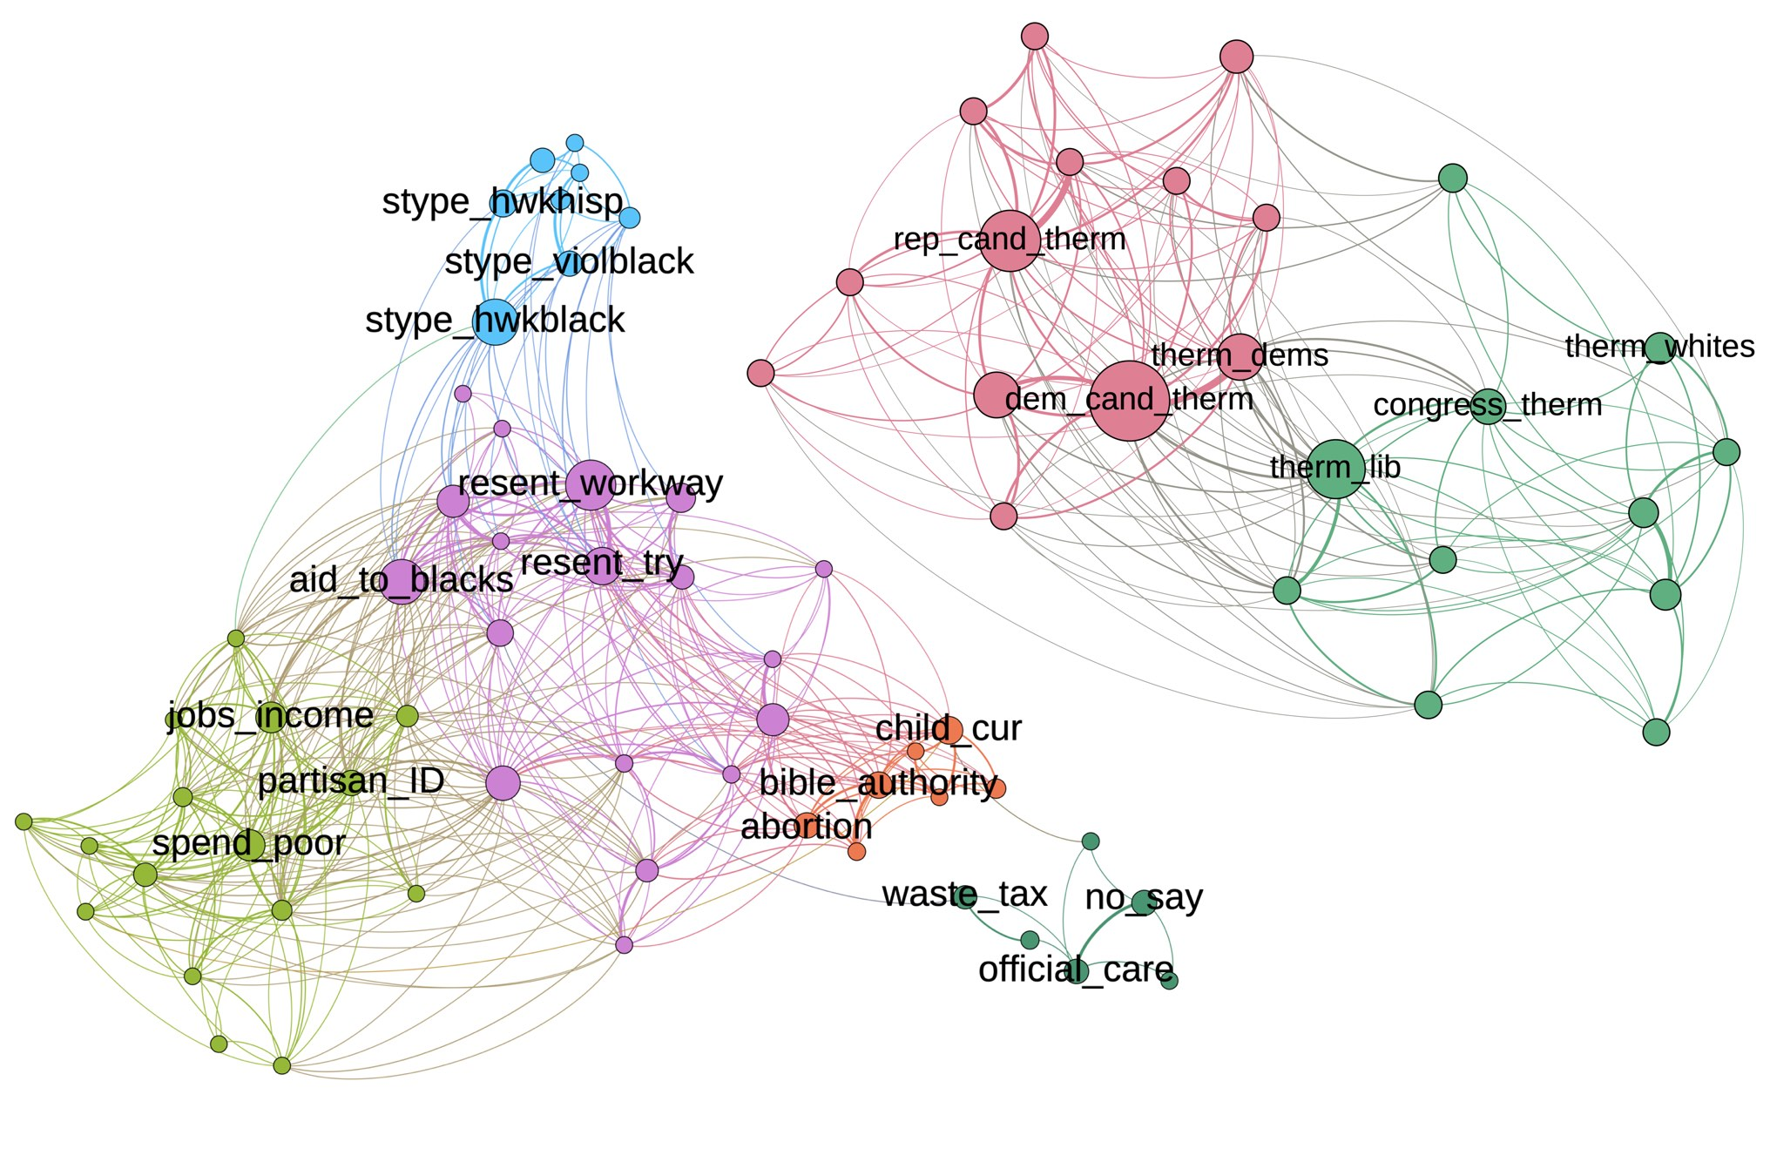
The 1992 Networks
Affective
Attitudinal
Notes:
Here are the separate networks from the 1992 survey, with the attitudinal network on the left and the affective network on the right.
A couple of notes before we talk substantively, which apply to all the networks I'll be showing you:
- First, for the sake of time, I'm simplifying a lot of the network analysis stuff, but I'm happy to talk more technical detail in the Q&A.
- On that note, these graphs have all been laid out algorithmically to cluster strongly connected nodes together.
- And color groups nodes into communities on a similar basis.
- Node size is scaled by how central the node is in the network.
- Tie thickness is scaled with edge weight (that is, squared correlation between items).
- Finally, for readability, I've omitted any ties with an absolute correlation below .15 and only included the node names for the three most central nodes in each community.
- Don't worry if the abbreviated names aren't clear; I'll be pointing out any specific nodes which substantively matter
What do we actually see though?
Well, there are some pretty immediate differences:
- The affective network is split into just 2 communities, while the attitudinal is network split into 5 well-defined and well-separated clusters
- Furthermore, the affective network has one pretty clear most central node (`dem_cand_therm`), while the attitudinal network has at least three plausible options (`resent_workway`, `aid_to_blacks`, and `stype_hwkblack`)
- Finally, though it may not be obvious at first glance because there are *more* connections in the attitudinal network, the average tie strength (or "density") is higher in the affective network
Despite those differences though, I'd argue that these are different species within the same genus, so to speak. The networks are different, but not radically so.
And this becomes even clearer when we look at the 2016 networks.
[click]

Slide 9
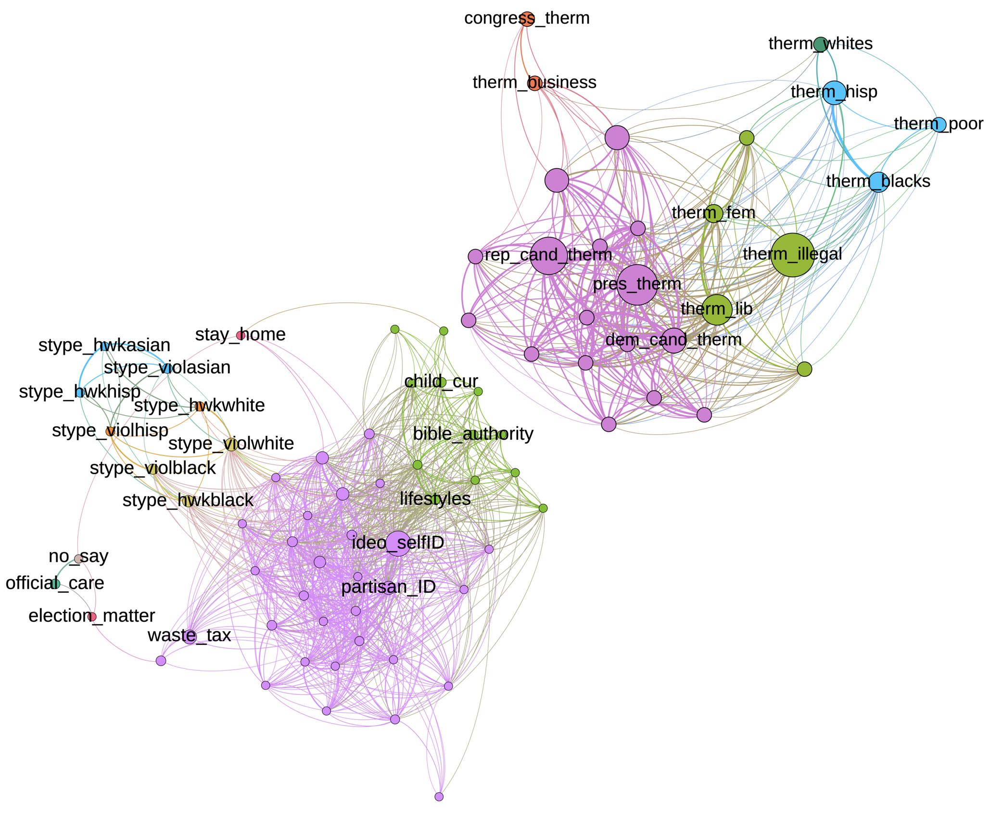
The 2016 Networks
Attitudinal
Affective
Notes:
The first thing to notice, however, is that both graphs have gotten significantly denser.
This is the replication we were looking for, because this is the increasing *constraint* which has been previously identified as evidence of polarization: a stronger and more consistent belief system in the population means more consistent lines of conflict.
We also see substantial differences between the two graphs, but not in the same ways as 1992.
In fact, I want to point out just how much the affective network here looks like the *attitudinal* network in 1992. Like that network,
- it has five well-defined and relatively separate communities
- as well as several different high centrality nodes competing for supremacy
By contrast, the attitudinal network has a clear single center around ideological identity (`ideo_selfID`).
And this is born out statistically: between 1992 and 2016 the attitudinal and affective networks literally *switch places* in terms of how centralized they are,
So not only do these networks all *look* relatively similar, they consistently live in the same statistical neighborhood.
Both networks also see roughly equal drops in *modularity*, a measure of how meaningfully the assigned communities divide up the network.
That is, local structure matters comparatively less as the overall network gets denser and more connected.
So both political attitudes and affects grew more strongly connected, but attitudes did so by becoming more centrally organized, while the *whole affective field* became more coherent and consistent.
This actually goes beyond just finding increasing constraint and begins to characterize the nature of that constraint.
Bringing us to the final question: what does *combining* attitude and affect actually add?

Slide 10
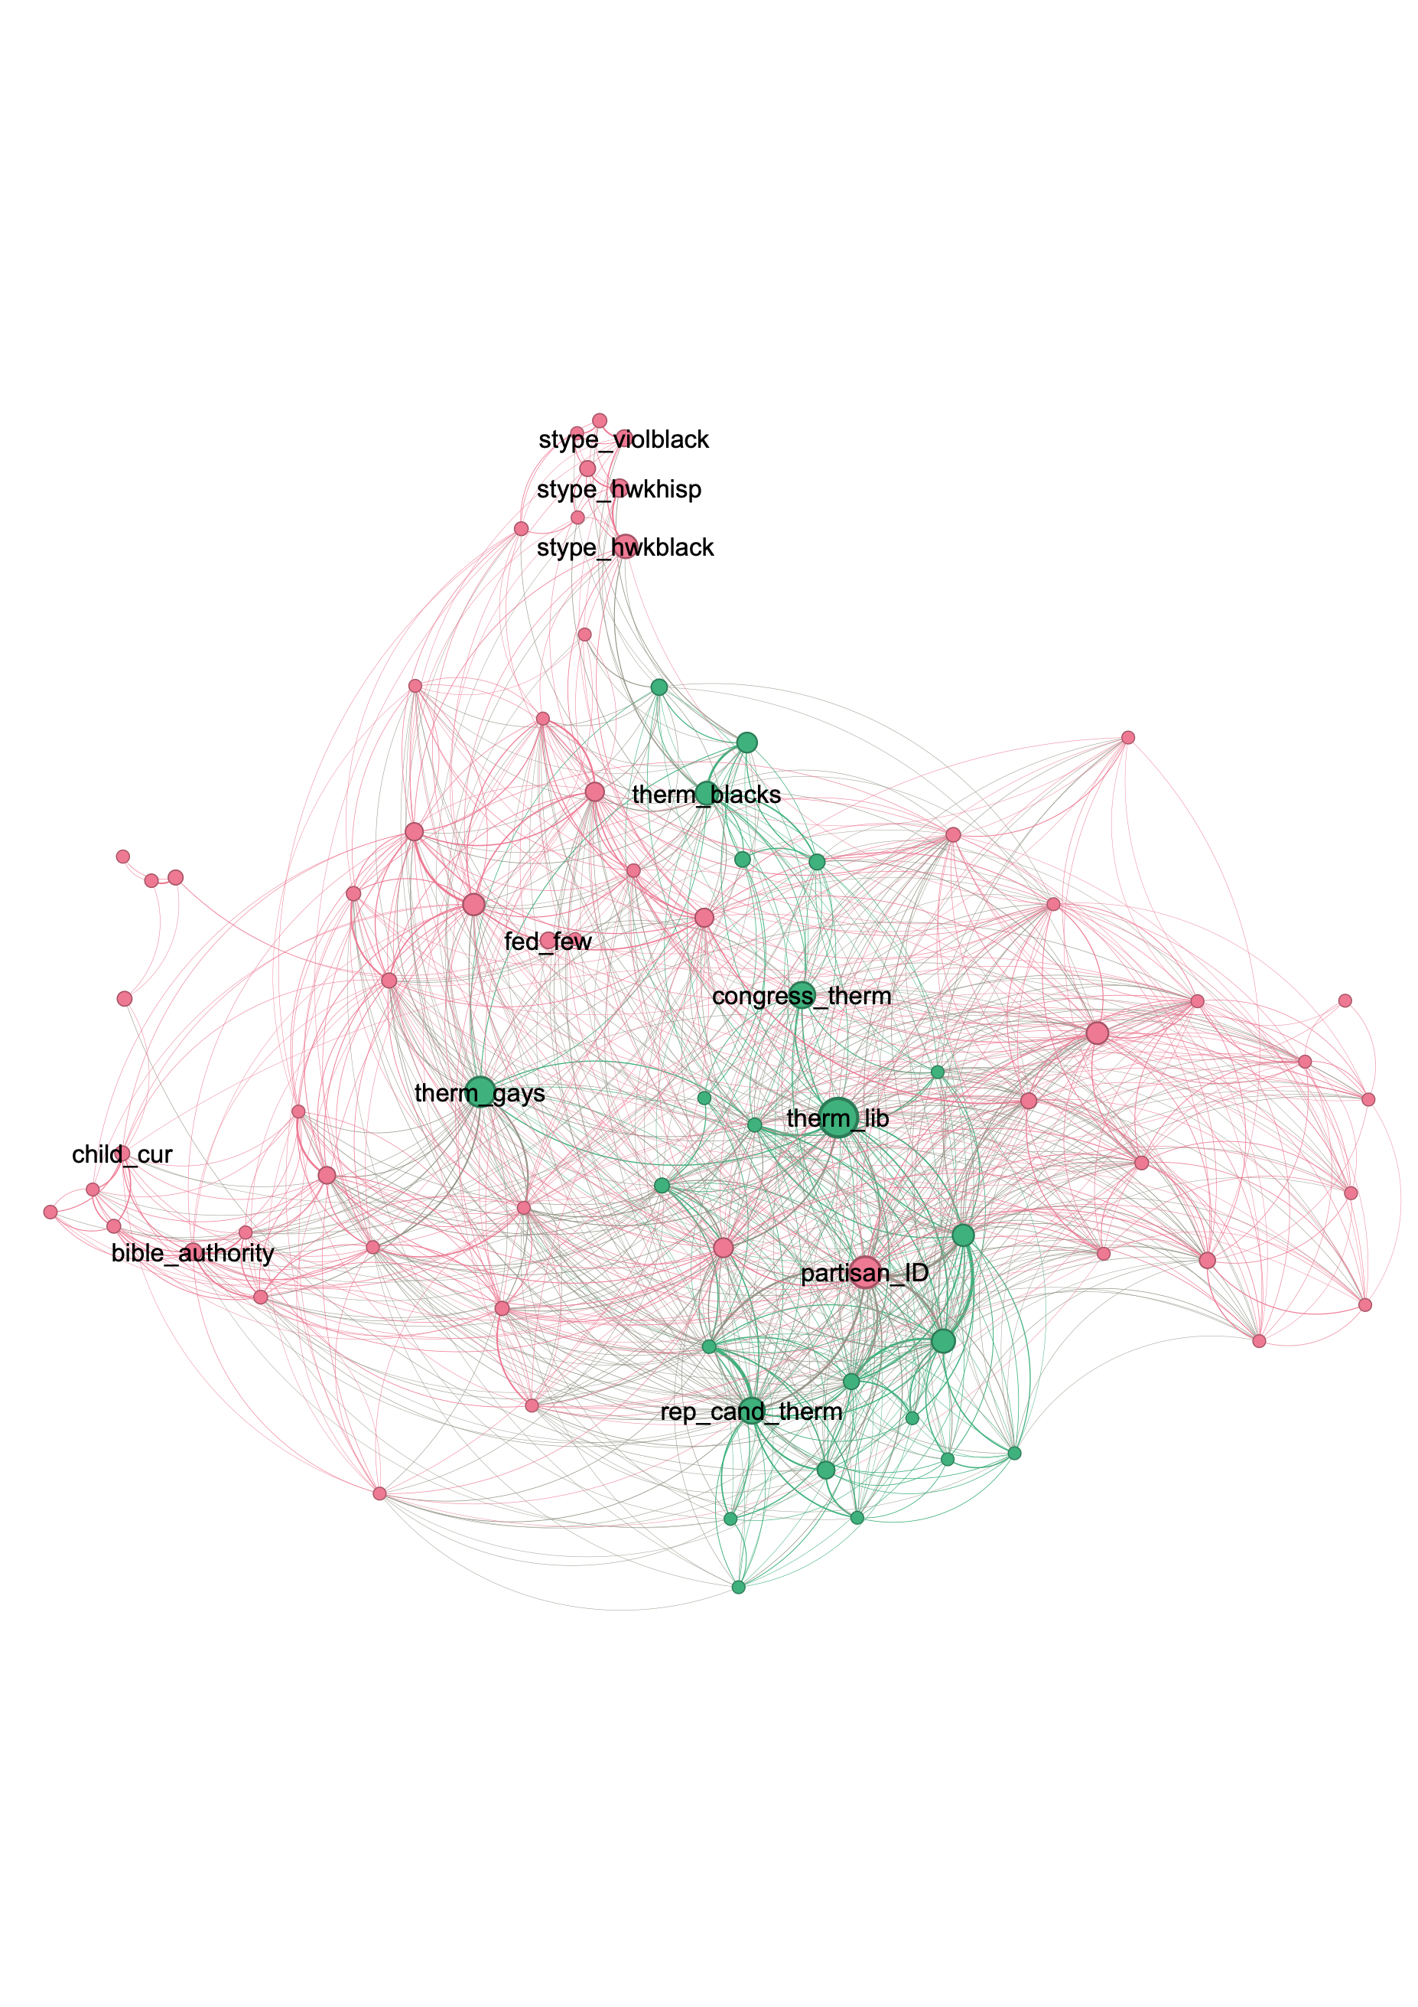
Combined: 1992
Notes:
Now, there's a lot we could talk about here, but I want to focus on one thing: just *how* the attitudinal and affective networks are connected.
So we're going to look at the combined networks, but instead of coloring nodes based on algorithmically assigned communities, I've colored them based on item type: pink for attitudes and green for affects.
[click]
The 1992 network here is our baseline: notice the relative separation of green and pink items; there are at most three or four attitudinal items with any real proximity or integration with affective items and the vast majority of strong (visible) ties *from* affective items are to *other affective items* (like the cluster of green at the bottom of the graph).
Now compare that to 2016 [click]

Slide 11
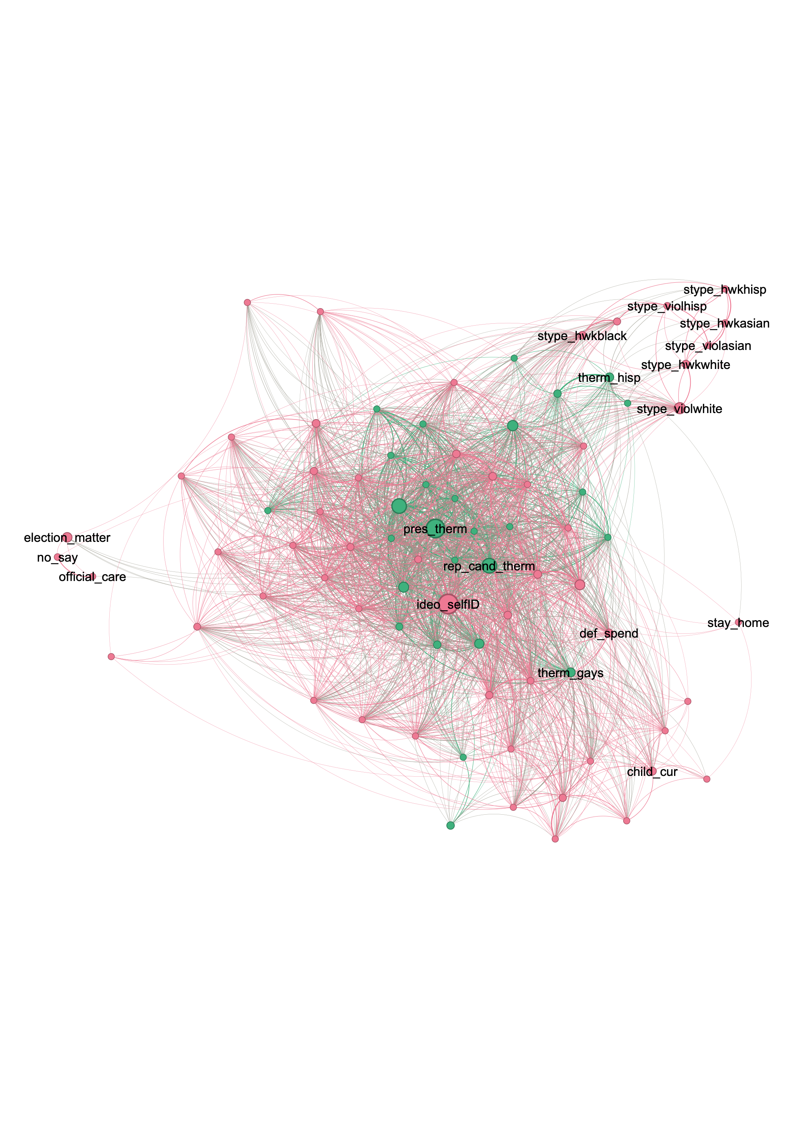
Combined: 2016
Notes:
Obviously, the 2016 network is just way denser on the whole. But that density is particularly concentrated in *cross-type* ties specifically. Now, same-type ties also strengthened on average, but the mean strength of cross-type (i.e., attitude-to-affect) ties *tripled*.
But attitudes and affects aren't just *more* connected, they're *jointly organized* in a way they just weren't in 1992.
This is, I think, visually obvious. The network coheres around around ideological self-ID and the presidential feeling thermometer.
These nodes have more or less equal centrality and are the centers of the separate attitudinal and affective networks respectively. But they're not acting here as independent centers of a bifurcated network.
Instead, they are a single *shared* center: very closely connected to each other and extremely similar in how densely they're tied to *both* attitudinal and affective items.
[click]

Slide 12
Something New
A binary star system
Combined attitudinal and affective center
A genuinely new finding
Previously seen theoretically and qualitatively
But this quantitative, macro operationalization is new
Only visible by treating attitude and affect together
Notes:
What we have here, then, is a binary star system. [click]
A network organized around the joint gravitational pull of a combined attitudinal and affective center. [click]
In other words, from 1992 to 2016, beliefs and emotions grew more and more tightly coupled in a single combined network, one organized more and more centrally around ideological identity and partisan affect.
[click] This is a genuinely *new* finding.
[click] While the close coupling between attitude and affect has been foregrounded theoretically and qualitatively in previous work on polarization, and is even (to an extent) *implied* by constraint based theories,
[click] it has not really been operationalized quantitatively (at least not at this scale).
We were able to use belief network analysis is to get at it directly.
[click] But only because we started by bringing affect into our understanding of belief systems.
[click]

Slide 13
The Meaning of Disagreement
Which disagreements matter?
Surely not all of them
But no a priori way to know
Integration of attitude and affect can answer:
How does disagreement feel?
And provide a synthesis:
Polarization is a worldview
Affect is core to what belief actually means
Notes:
This same innovation helps answer a core question about constraint.
Constraint based theories of polarization focus on the structure of disagreement, how different attitudes line up with each other, but [click]*which* disagreements matter?
On the one hand, [click] they almost certainly don't all matter, but at the same time, [click] there's no a priori set of "important" opinion cleavages. Indeed, which opinions matter (and how) is itself a variable of interest (and definitive of polarization in some theories).
[click] But the integration of attitude and affect provides an answer: [click] how does a given disagreement *feel* (to people)?
[click] And this is then the core of our synthesis of affect and constraint based theories of polarization [click]: Polarization is defined neither by a single affect nor an assemblage of propositional attitudes, but by a constellation of affects and attitudes which define how political conflict is understood and *felt* and therefore the nature of that conflict. In essence, polarization is a kind of *worldview*.
[click] Which ultimately shows us why affect must be core to thinking about belief systems: because affect is core to understanding what belief actually *means* at all.
[click]

Slide 14
Thank You!
Questions or Comments?
Steven Lauterwasser
s.lauterwasser@northeastern.edu
stevenlauterwasser.com
@strophios
Notes:
Thank you!

